Slide 1


WEB BASED PLACEMENT MANAGEMENT SYSTEM
Group Members:
K Naveen kumar Racharla Dhanraj
Edulakanti Anil
Challa Uday kiran
Boga Manoj
Konda Hari Prasad
TNSIF UID:
T050601934
T050601942
T050601916
T050601968
T050601931
T050601920
11

Slide 2

Problem Statement
The "WEB BASED PLACEMENT MANAGEMENT SYSTEM USING CERTIFICATE AUTHENTICATOR" project aims to streamline student placement processes within educational institutions by implementing a web-based platform. This system enables efficient management of student information, facilitates fast access to placement-related procedures, and ensures one-time registration for students. Additionally, it allows placement cells to invite companies for campus interviews, provides companies with selective access to student resumes, and enables administrators to manage job details of placed students. Overall, the system enhances efficiency, accuracy, and transparency in managing placement activities.

Slide 3

Road Map
Application will be developed in following Sprints –
POSTMAN->Spring REST Controller->
Service Layer->
Spring Data JPA Repository Layer->
Database .

Slide 4

Plan
Design
Generate the skeleton as per class design provided
TDD approach
Identify test cases for each module
Write Failing Test cases
Convert the Test Cases in GREEN
Implement the case study in incremental manner

Slide 5
Modules:
Login Module:
Placement schedule module:
All university and corporate must login into the website to view student information, placement schedule information. All user names and password must be protected by using this module, which means that for each user, there must be unique username and password.
In this module corporate can schedule a campus placement in particular university by giving the following information
Schedule date
Qualification
Year

Slide 6
Modules:
Student process module:
Search module:
In this module,
University can post new student data by giving the following information,
Student name
Qualification
Course
Year of passing
Certificate
Corporate can download the certificate of a particular candidate by giving following information
Student name
Hal ticket number
In this module corporate can search for candidate information. The search process is working based upon the search string, which is related to name or hall ticket number

Slide 7

Class Design
College
POJO Classes:
1
-Id : long
-collegeName : String
-location : String
Student
1
-id : long
-name : String
-roll : long
-qualification : String
-course : String
*
1
1
*
Certificate
1
-id : long
-year : int
-college : String
1
Placement
-id : long
-name : String
-qualification : String
-year : int
*
1
User
-id : long
-name : String
-password : String
Admin
1
-id : long
-name : String
-password: String
1
7

Slide 8
Student
Certificate
-id : long
-name : String
-roll : long
-qualification : String
-course : String
-id : int
-year : int
-college : String
1
1

Slide 9
College
-Id : long
-collegeAdmin : User
-collegeName : String
-location : String
1
1
Student
*
-id : long
-name : String
-roll : long
-qualification : String
-course : String
*
Certificate
-id : long
-year : int
-college : College
1
1

Slide 10
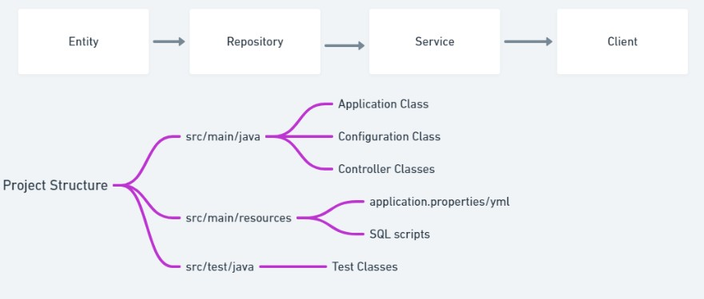
Flow Chart

Slide 11
Class Design
Service Interface:
PlacementService
+addPlacement(Placement placement) : Placement
+updatePlacement(Placement placement) : Placement
+searchPlacement(long id):Placement
+cancelPlacement(long id):boolean
StudentService
+addStudent(Student student) : Student
+updateStudent(Student student) : Student
+searchStudentById(long id):Student
+searchStudentByHallTicket(long ticketNo) : Student
+addCertificate(Certificate certificate): Boolean
+updateCertificate(Certificate certificate): Boolean
+deleteStudent(long id):boolean
CertificateService
+addCertificate(Certificate certificate) : Certificate
+updateCertificate(Certificate ertificate) : Certificate
+searchCertificate(long id): Certificate
+deleteCertificate(long id):Certificate
CollegeService
UserService
+addCollege(College college) : College
+updateCollege(College college) : College
+searchCollege(long id): College
+deleteCollege(long id):Boolean
+schedulePlacement(Placement placement): boolean
+addNewUser(User user) : User
+updateUser(User user) : User
+ login(User user): User
+logOut():boolean

Slide 12
Class Design
Repository Interface:
PlacementRepository
StudentRepository
+addPlacement(Placement placement) : Placement
+updatePlacement(Placement placement) : Placement
+searchPlacement(long id):Placement
+addStudent(Student student) : Student
+updateStudent(Student student) : Student
+searchStudentById(long id):Student
+searchStudentByHallTicket(long ticketNo) : Student
+deleteStudent(long id):boolean
CertificateRepository
+addCertificate(Certificate certificate) : Certificate
+updateCertificate(Certificate ertificate) : Certificate
+searchCertificate(long id): Certificate
+deleteCertificate(long id):Certificate
CollegeRepository
+addCollege(College college) : College
+updateCollege(College college) : College
+searchCollege(long id): College
+deleteCollege(long id):Boolean
UserRepository
+addNewUser(User user) : User
+updateUser(User user) : User
+deleteUser(long id) : User

Slide 13


Use case diagram for University/Colleges
Use case diagram for Corporate
Add student data
Upload Certificate
Search Student
Login/Register
Login/ Register
View Certificate
University/College
Schedule Placement Drive
Corporate
Search for College/University
Search Students
Update Student Data
View Pending Corporate Registration Requests
Use case diagram for Admin
Approve/Reject Request
Login/ Register
Admin
View Pending University Registration Requests
Approve/Reject Request

Slide 14
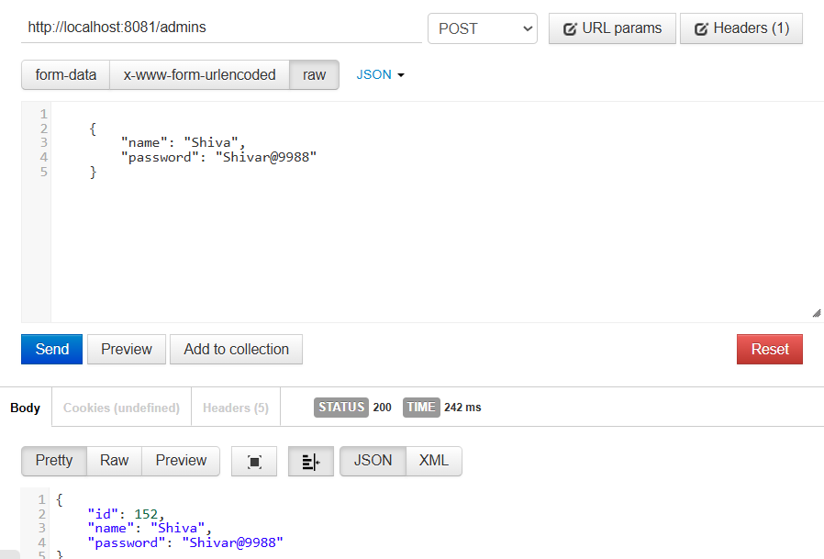
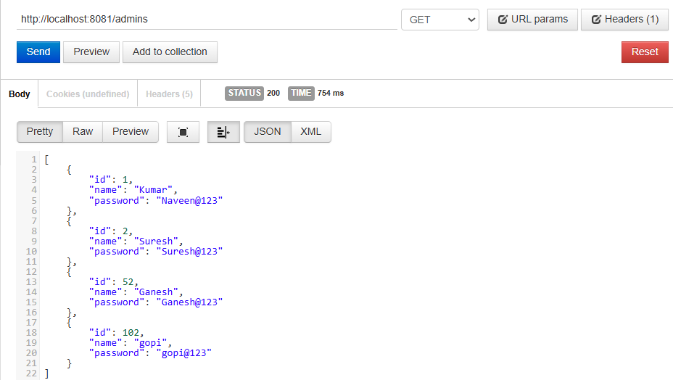
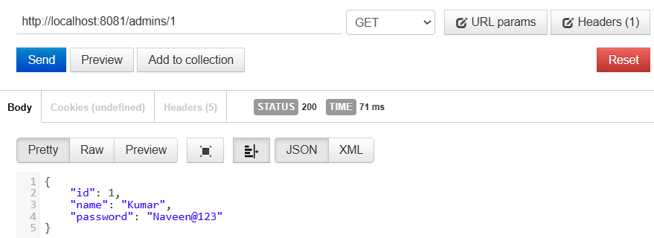
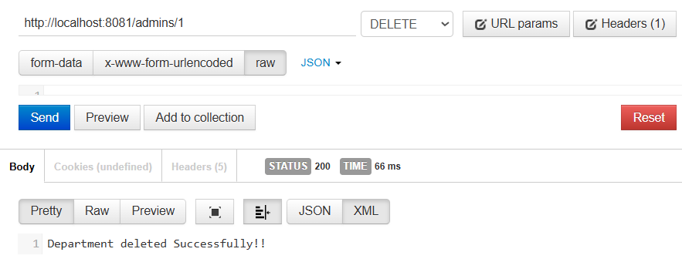
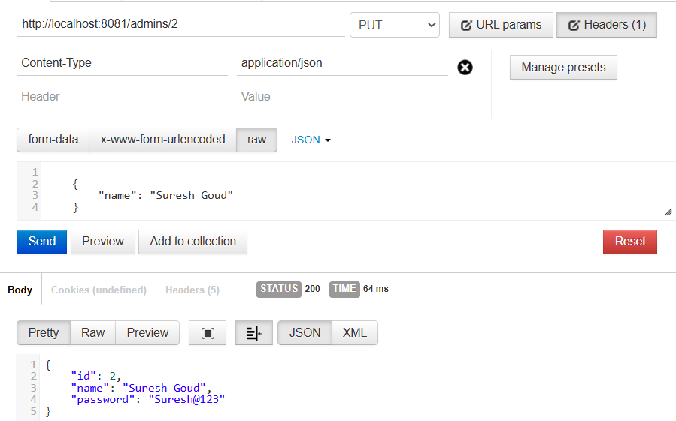
OUTPUTS:
Admin Entity
PostMapping of Admin Entity
GetMapping of Admin Entity
GetMappingById of Admin Entity
DeleteMappingById of Admin Entity
PutMapping of Admin Entity

Slide 15
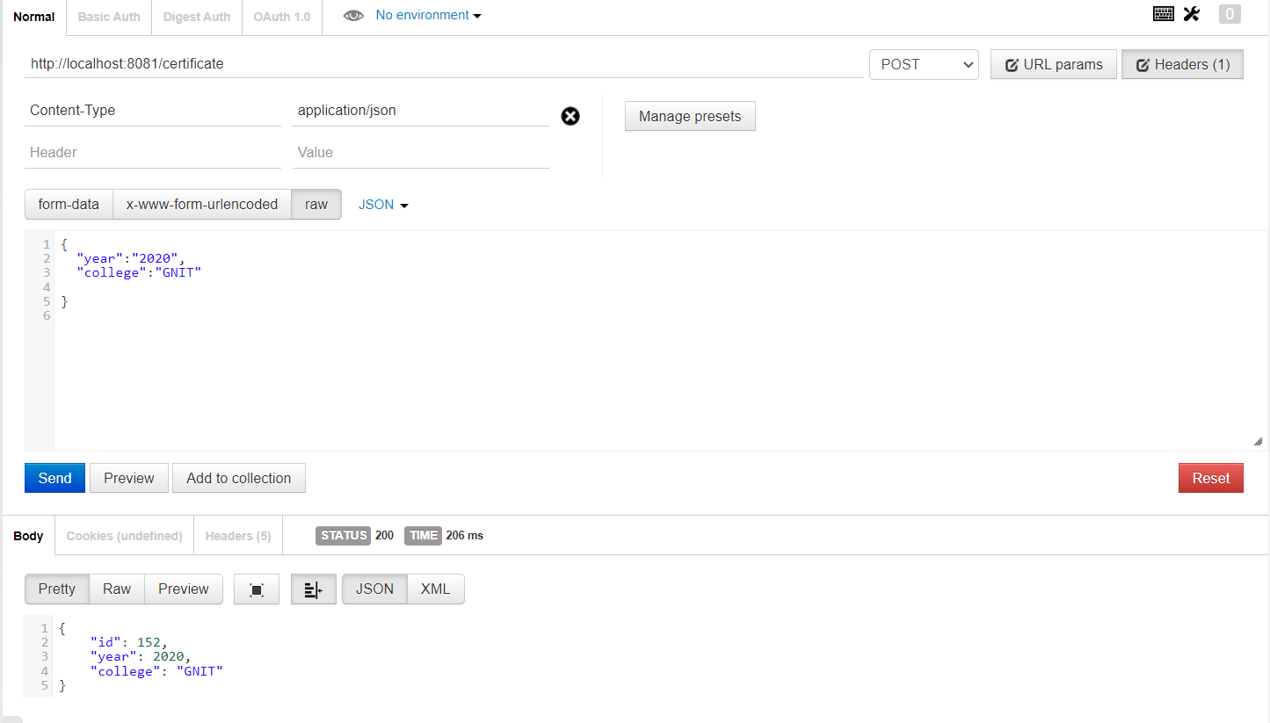
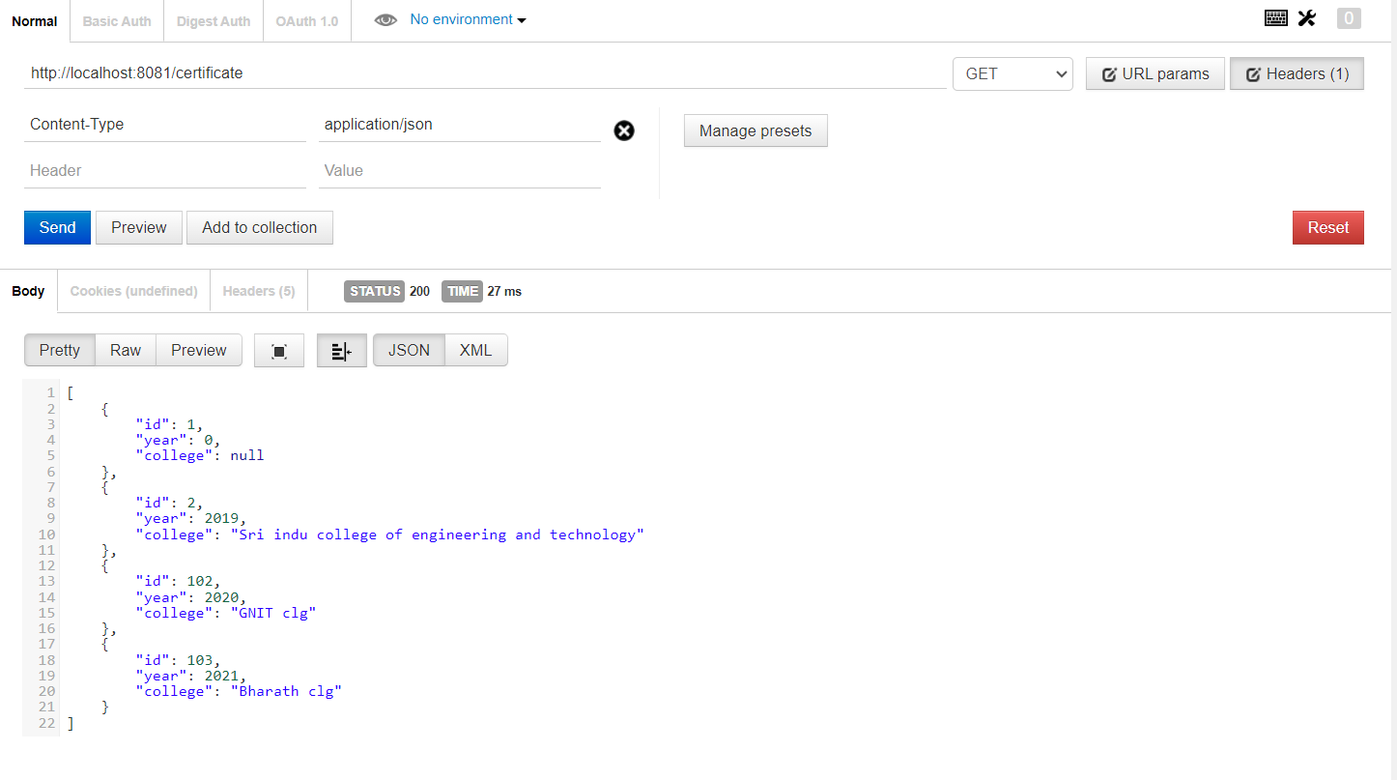
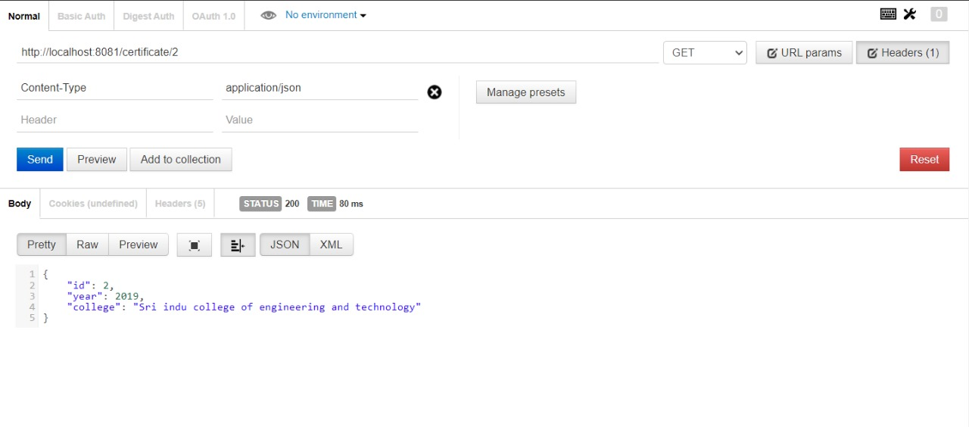
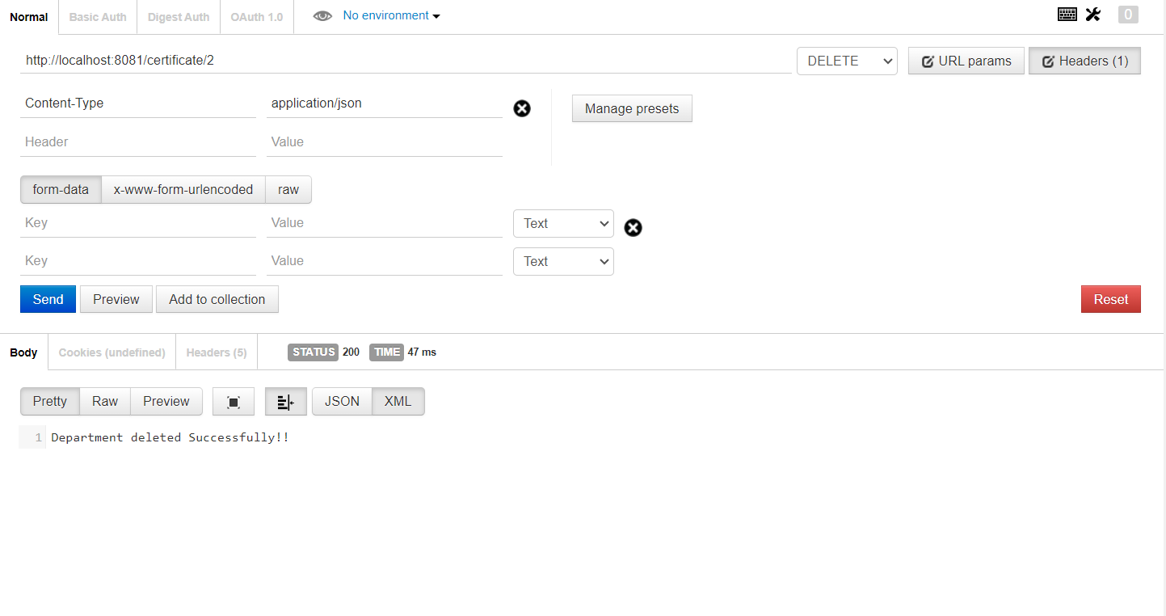
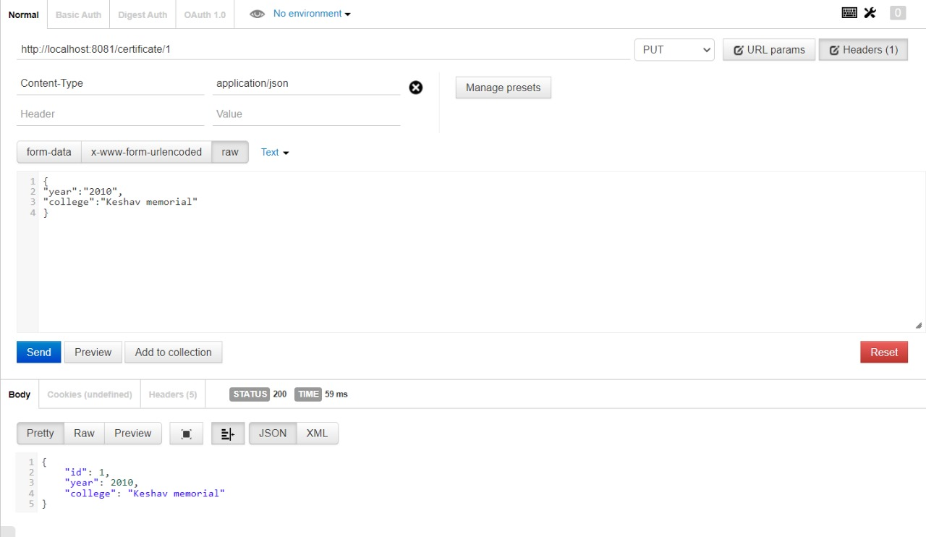
OUTPUTS:
Certificate Entity
PostMapping of Certificate Entity
GetMapping of Certificate Entity
GetMappingById of Certificate Entity
DeleteMappingById of Certificate Entity
PutMapping of Certificate Entity

Slide 16
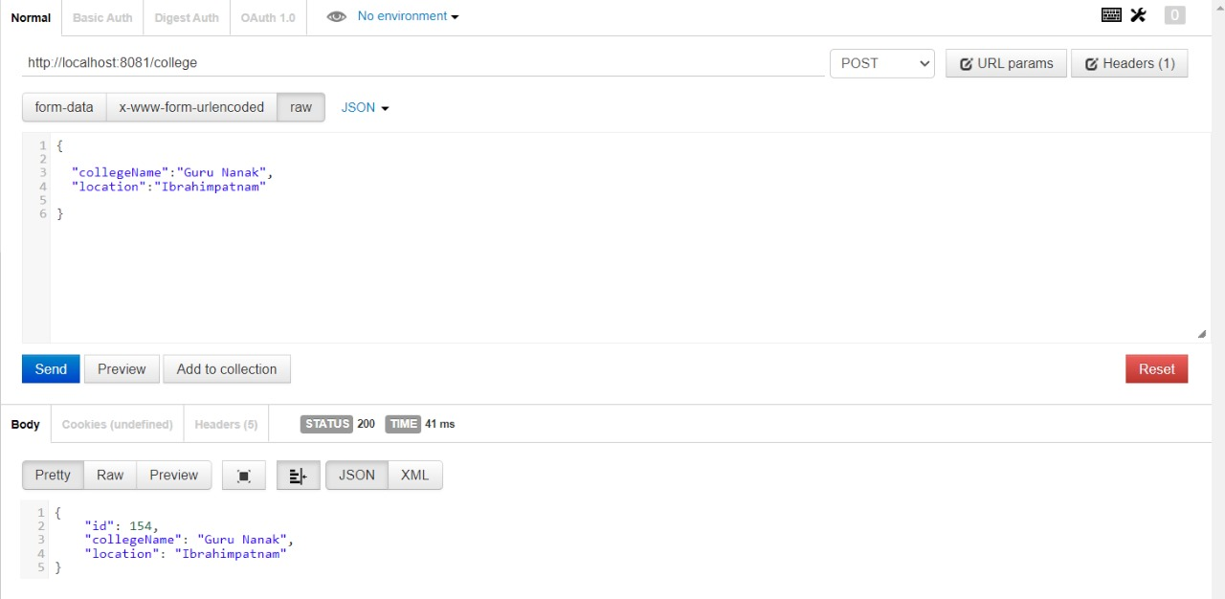
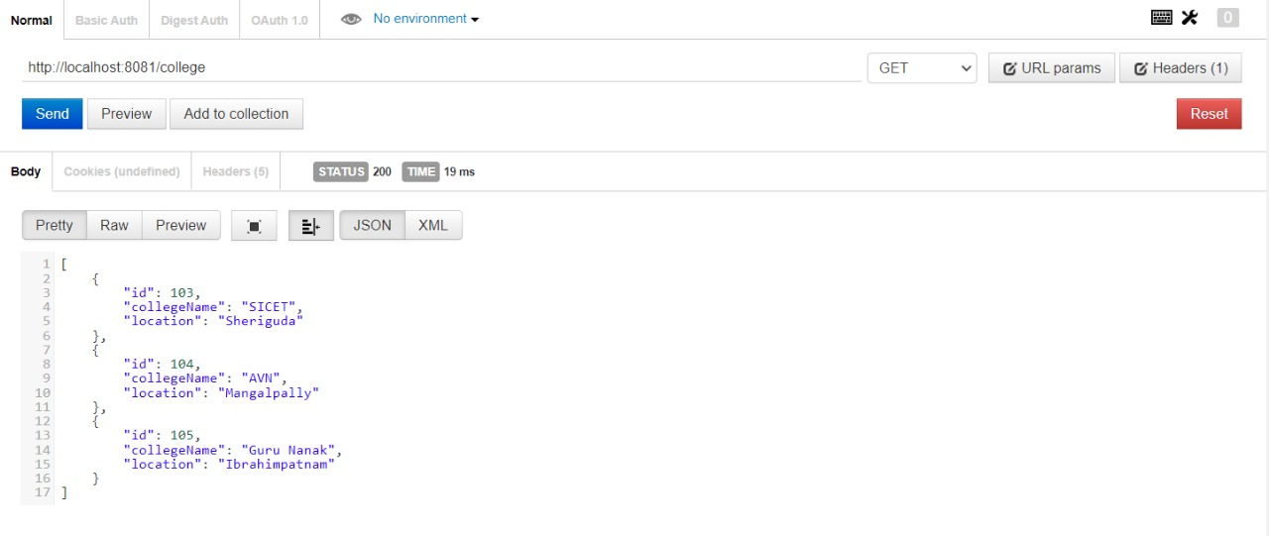
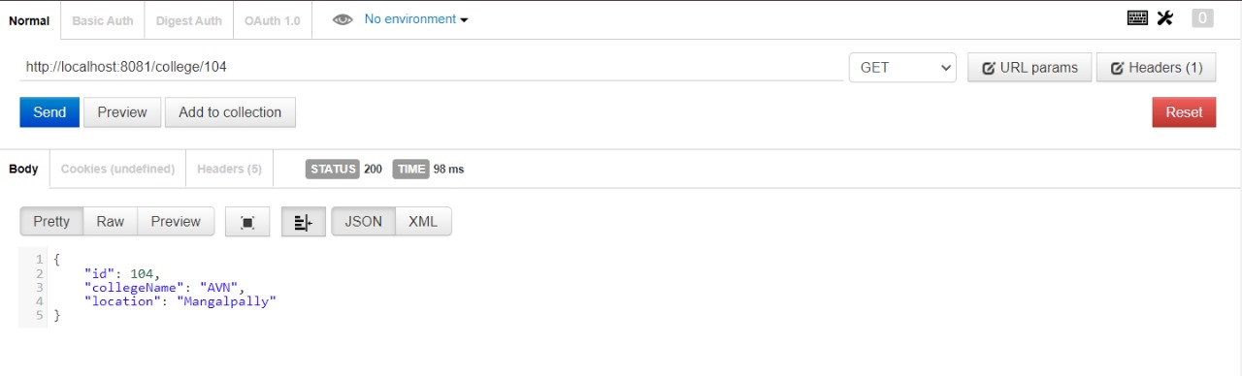
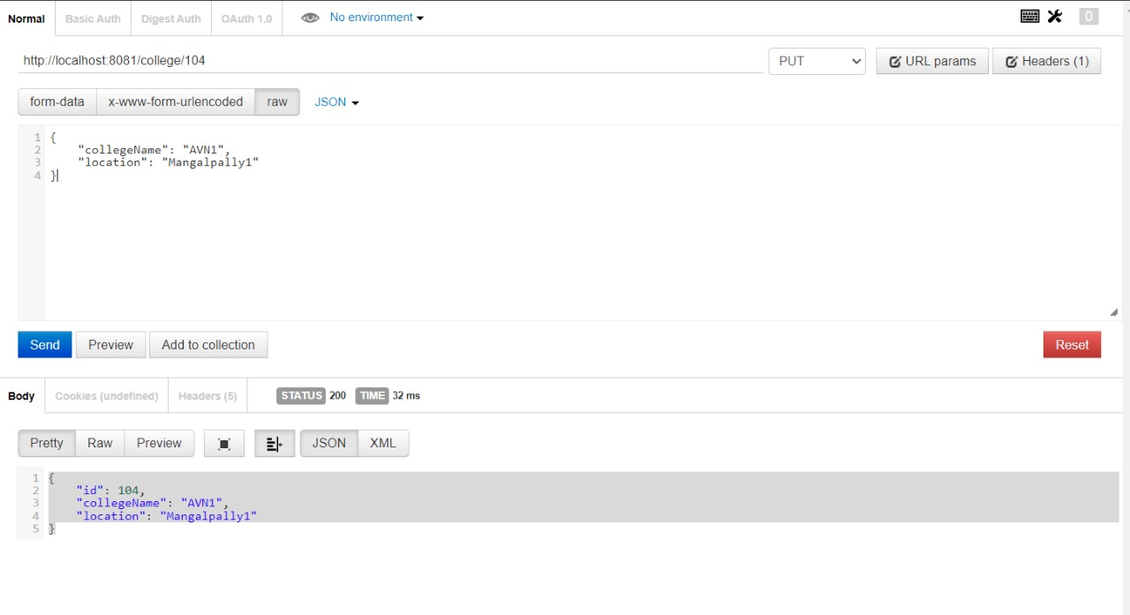
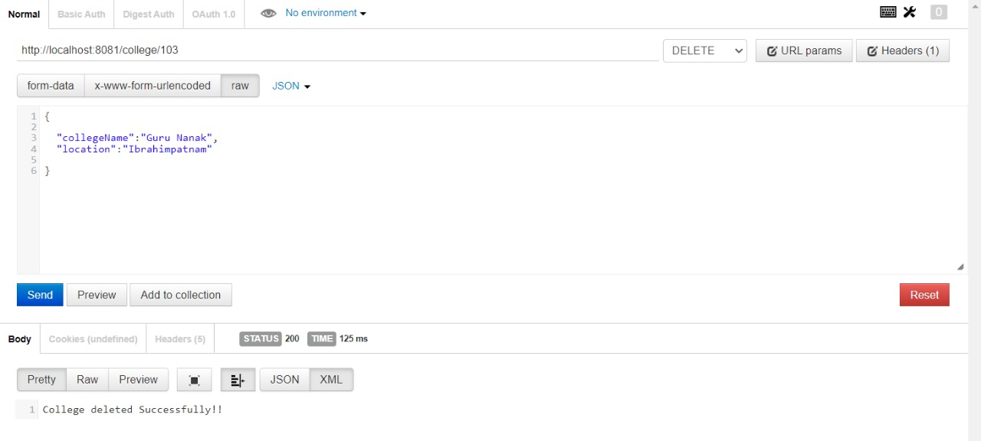
OUTPUTS:
College Entity
PostMapping of College Entity
GetMapping of College Entity
GetMappingById of College Entity
DeleteMappingById of College Entity
PutMapping of College Entity

Slide 17
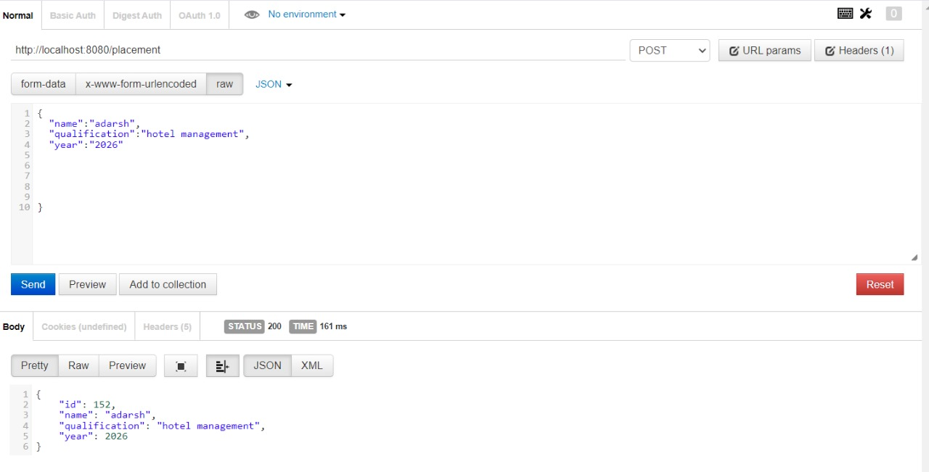
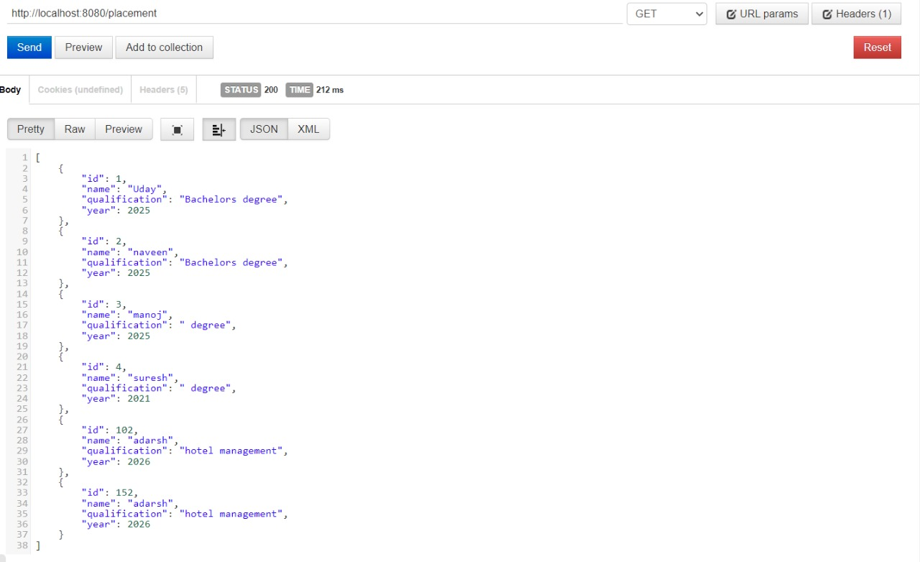
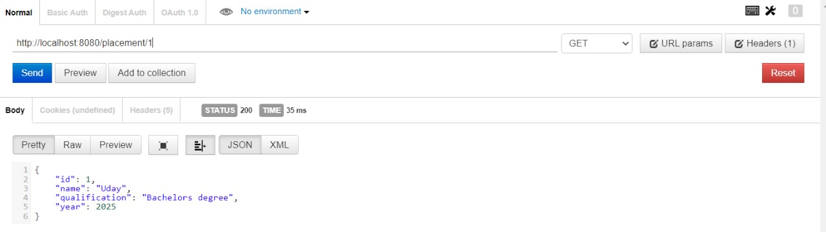
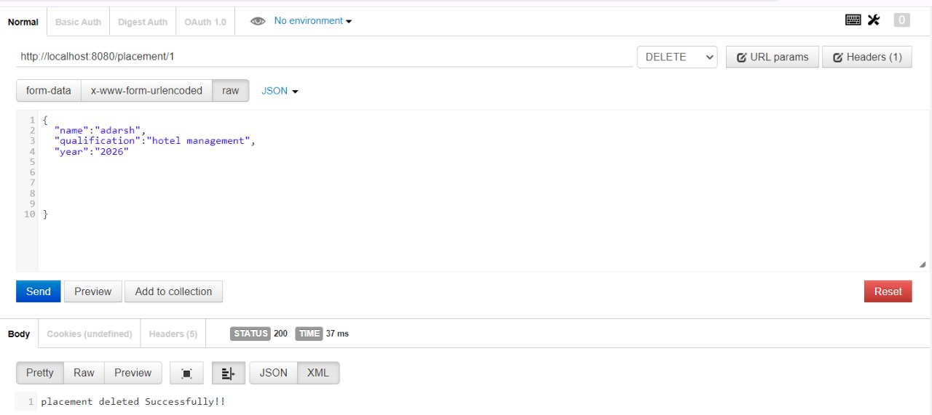
OUTPUTS:
Placement Entity
PostMapping of Placement Entity
GetMapping of Placement Entity
GetMappingById of Placement Entity
DeleteMappingById of Placement Entity
PutMapping of Placement Entity

Slide 18
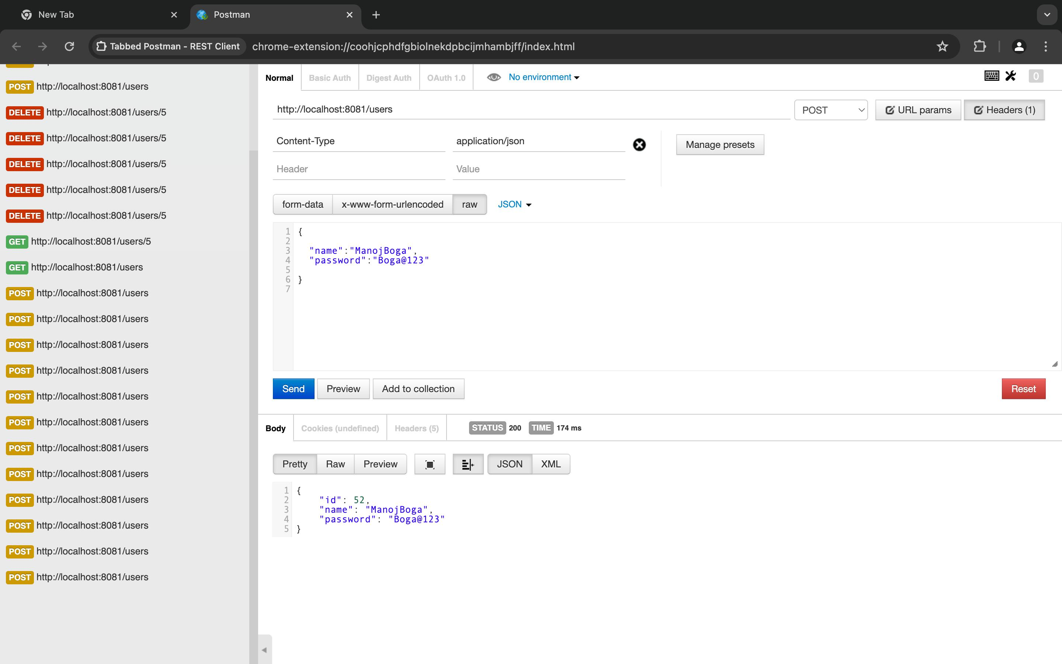
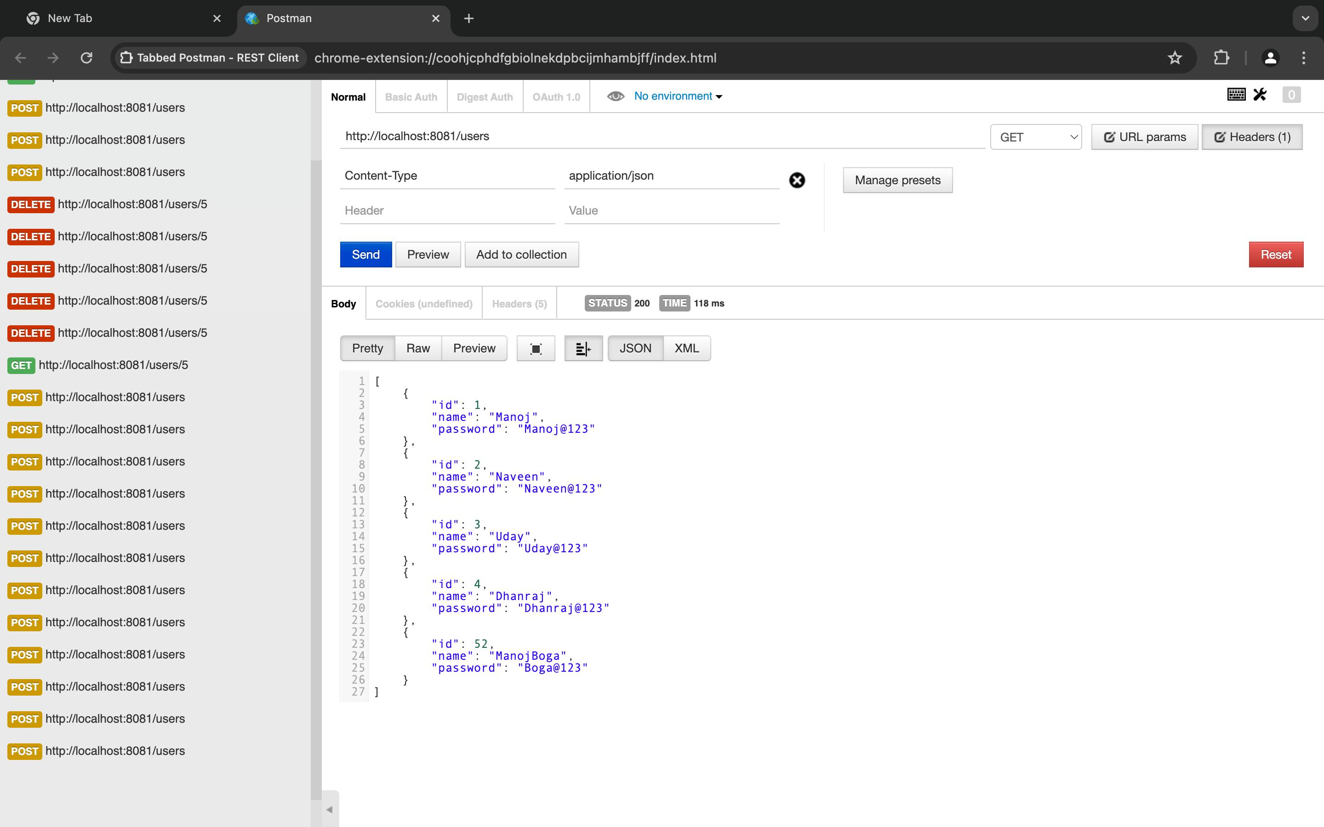
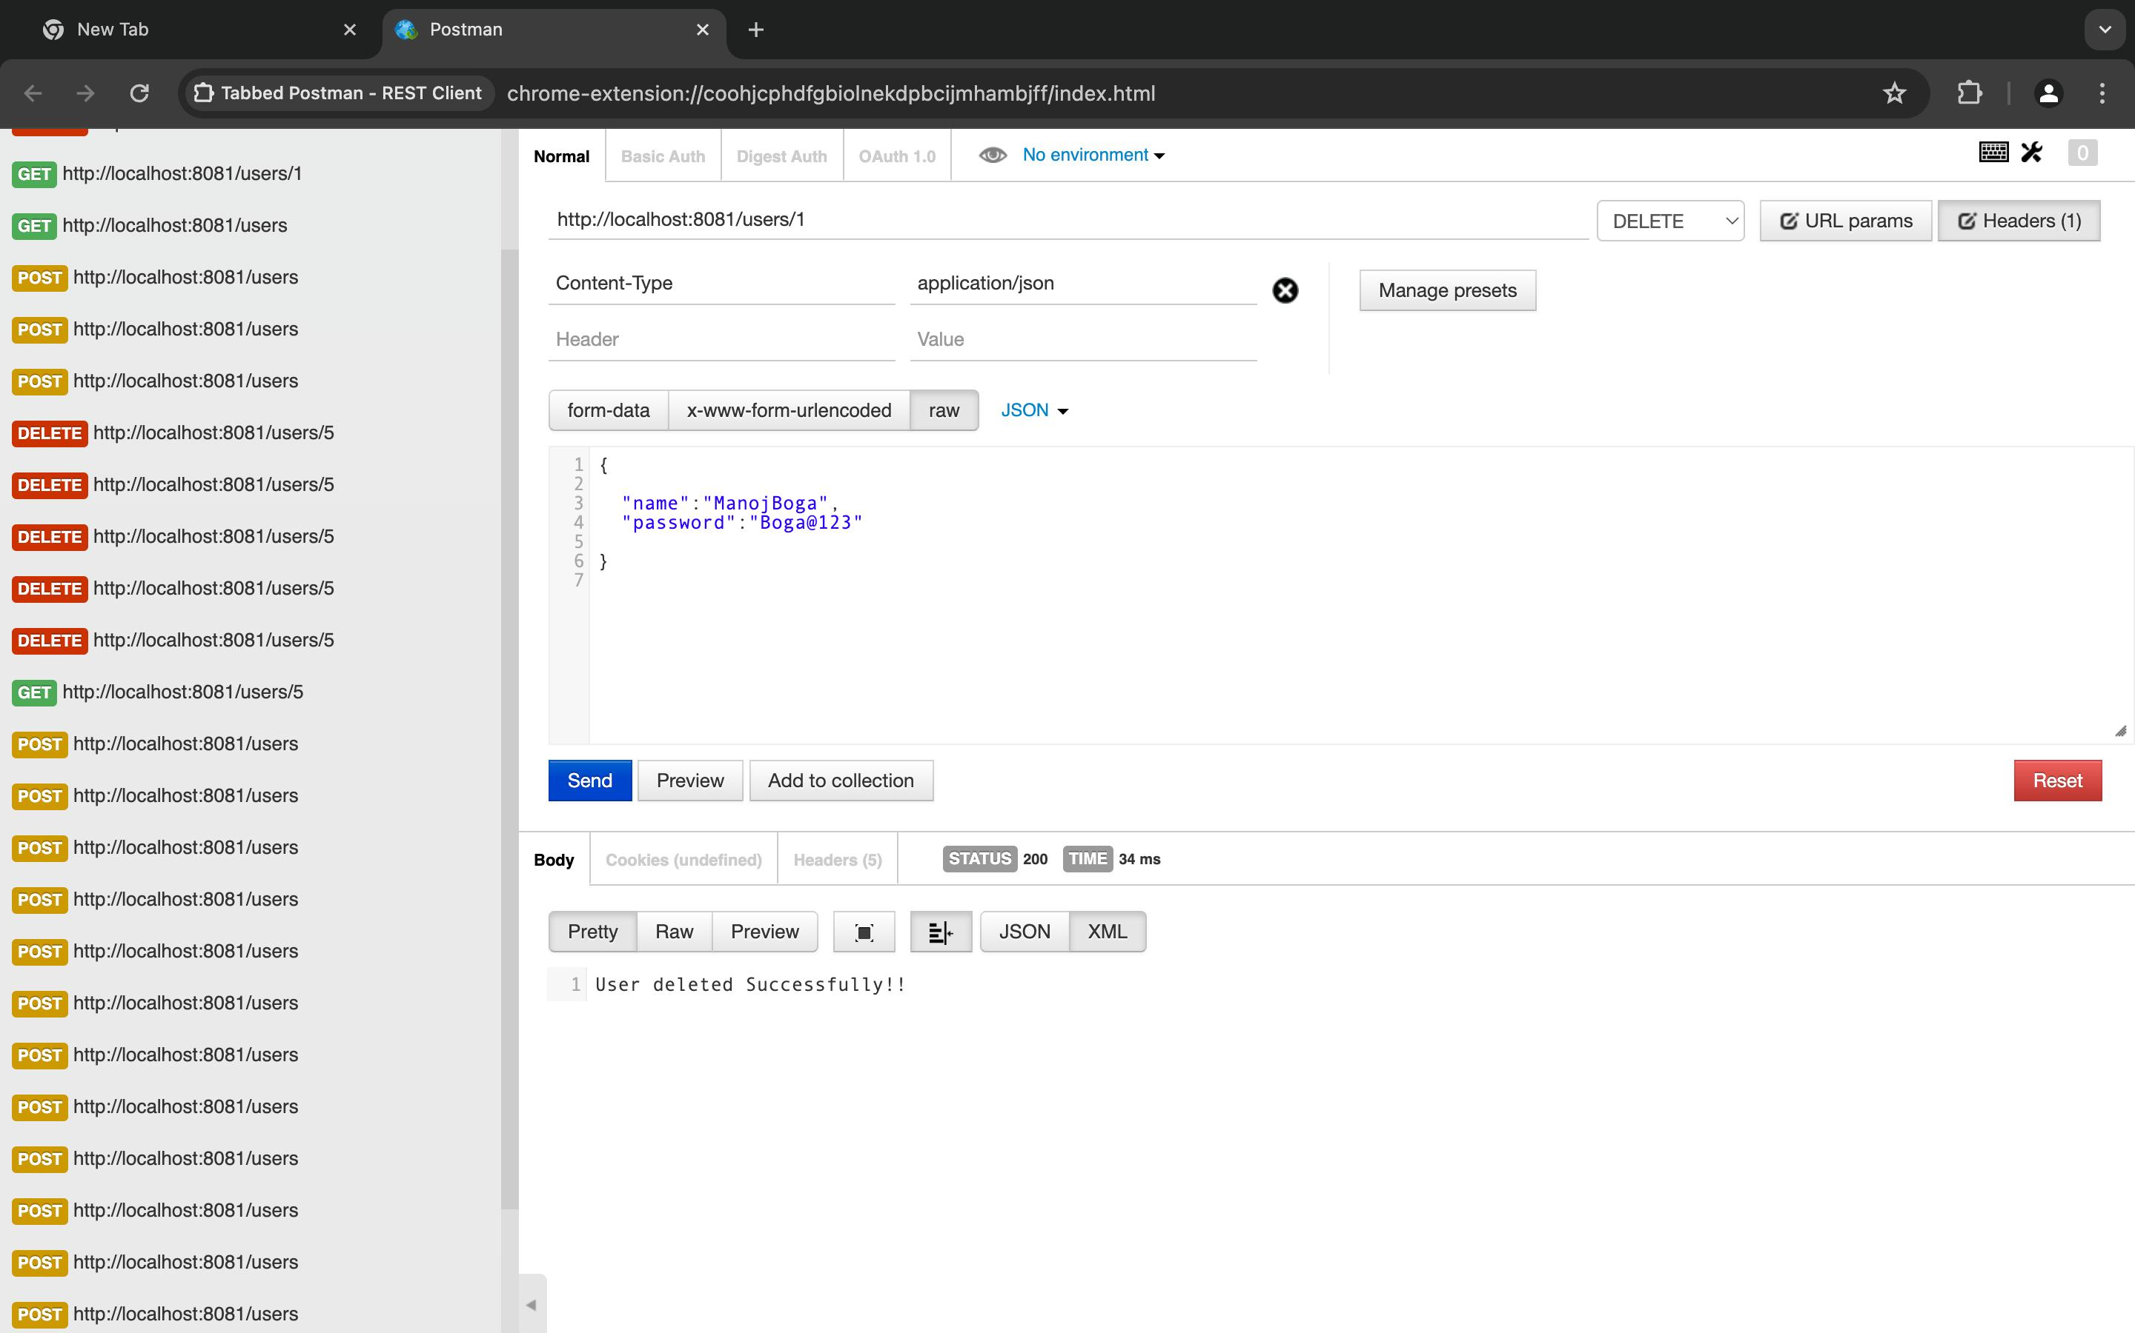
OUTPUTS:
User Entity
PostMapping of User Entity
GetMapping of User Entity
GetMappingById of User Entity
DeleteMappingById of User Entity
PutMapping of User Entity

Slide 19
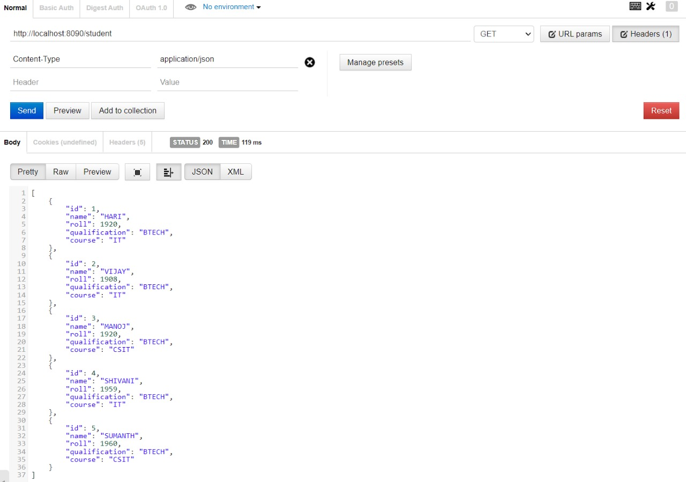
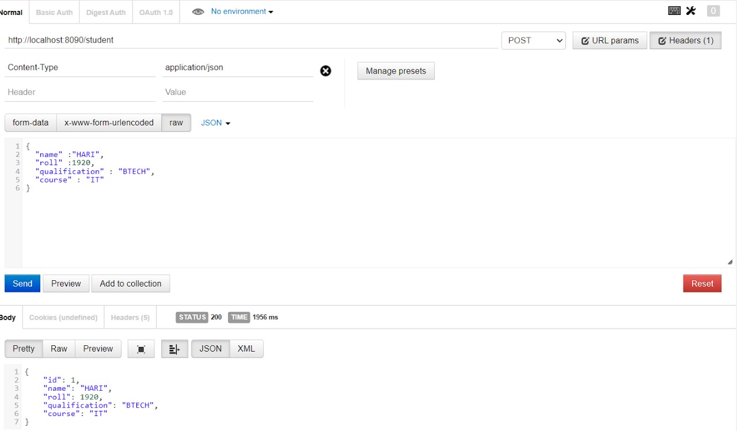
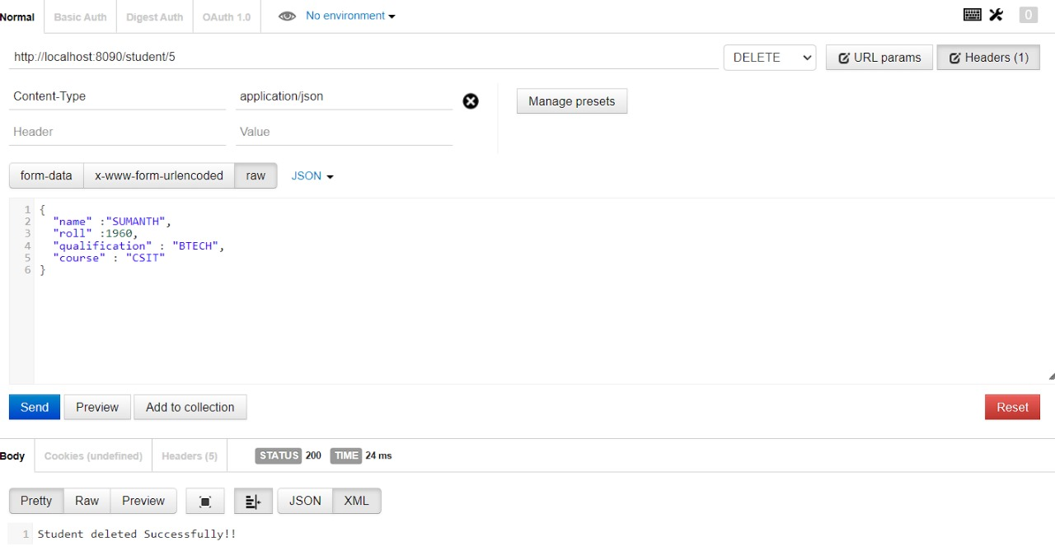
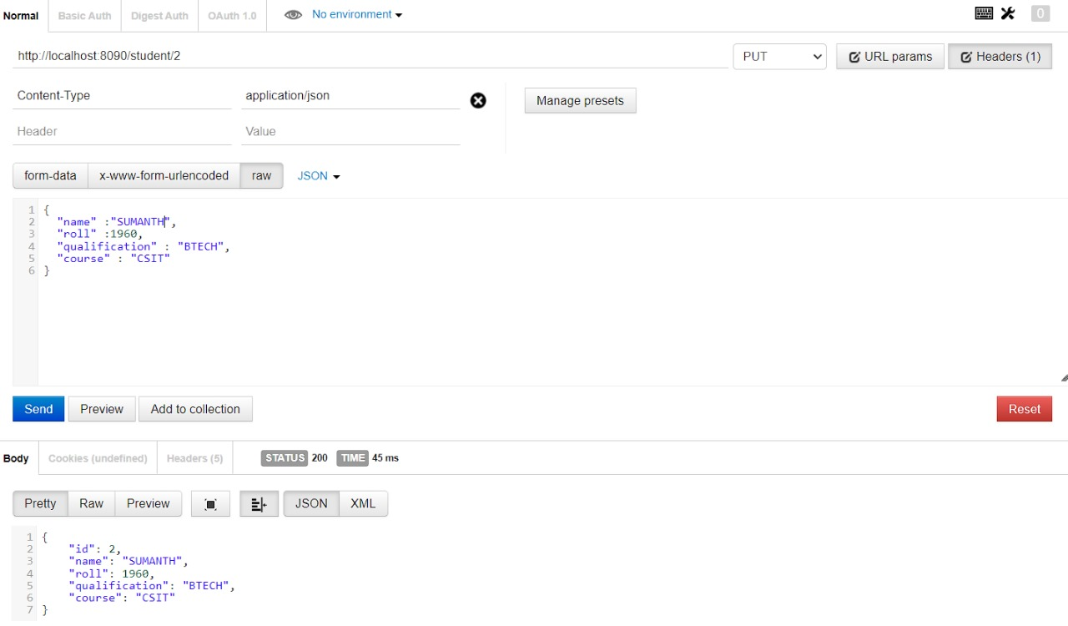
OUTPUTS:
Student Entity
PostMapping of Student Entity
GetMapping of Student Entity
GetMappingById of Student Entity
DeleteMappingById of Student Entity
PutMapping of Student Entity

Slide 20

Thank You

